Slide 1
This is CS50

Slide 2
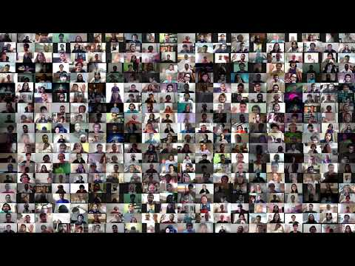

Slide 3
This is CS50

Slide 4


Slide 5


Slide 6
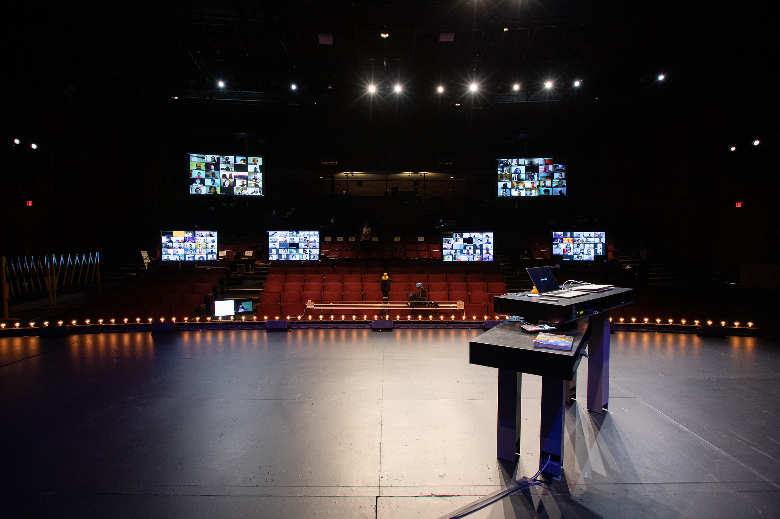

Slide 7
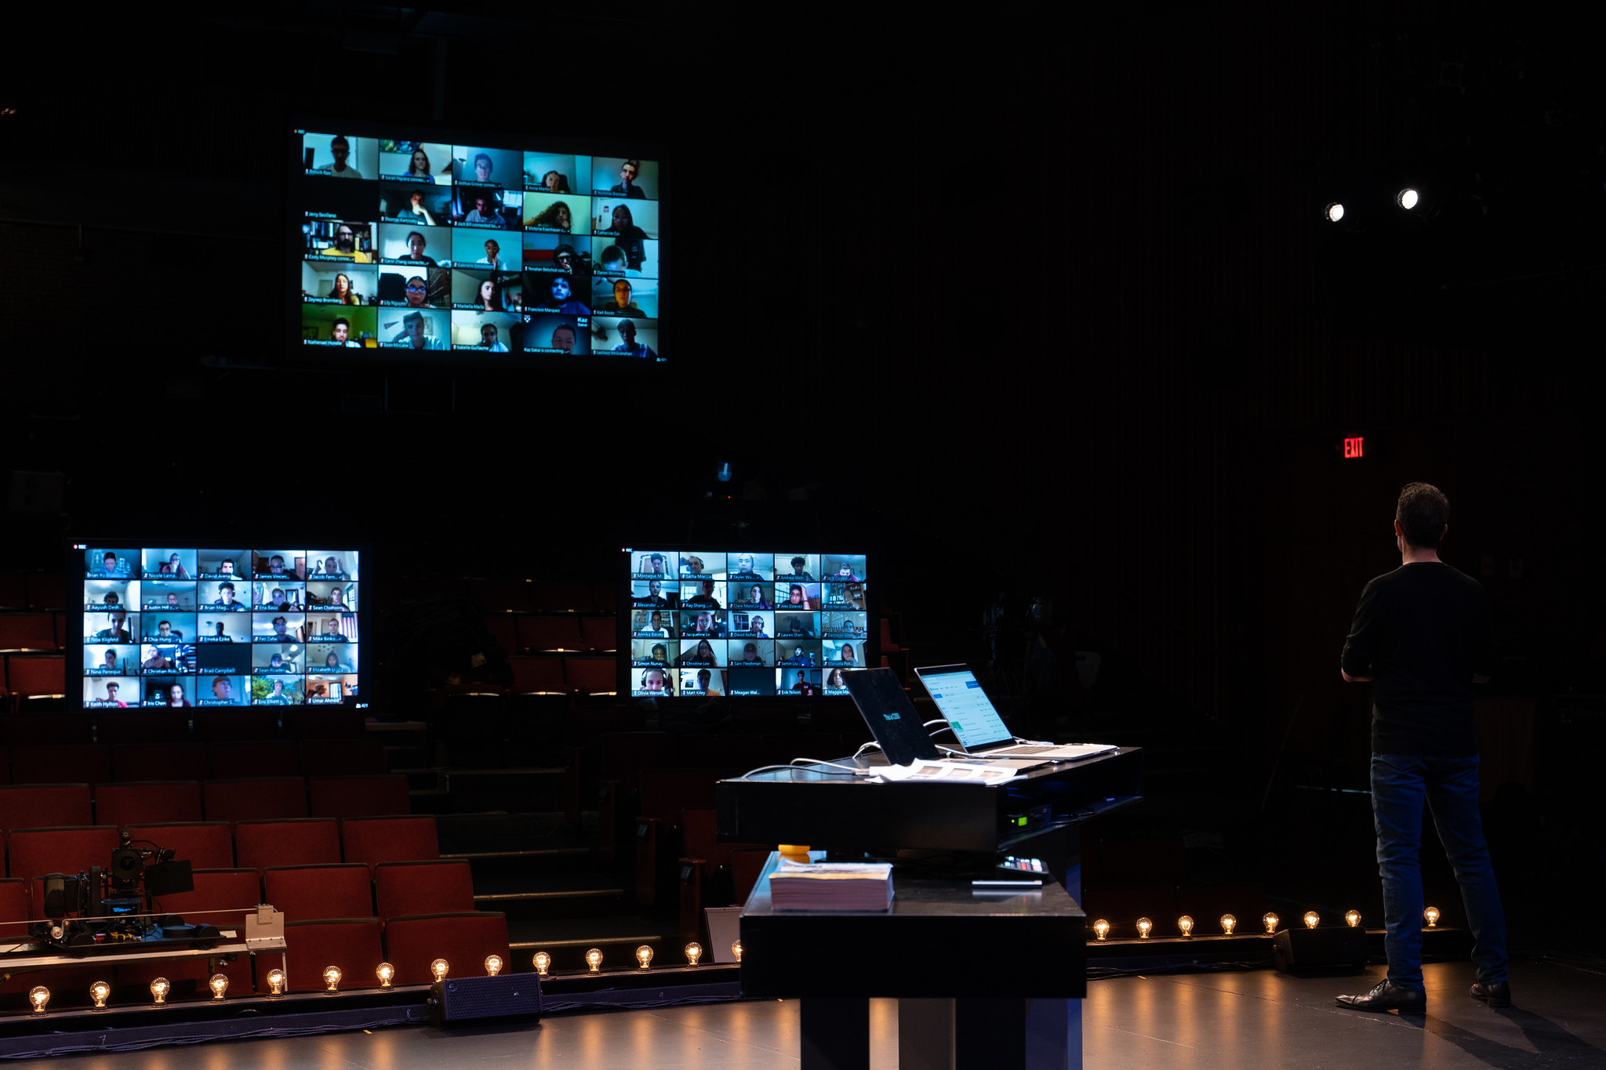

Slide 8
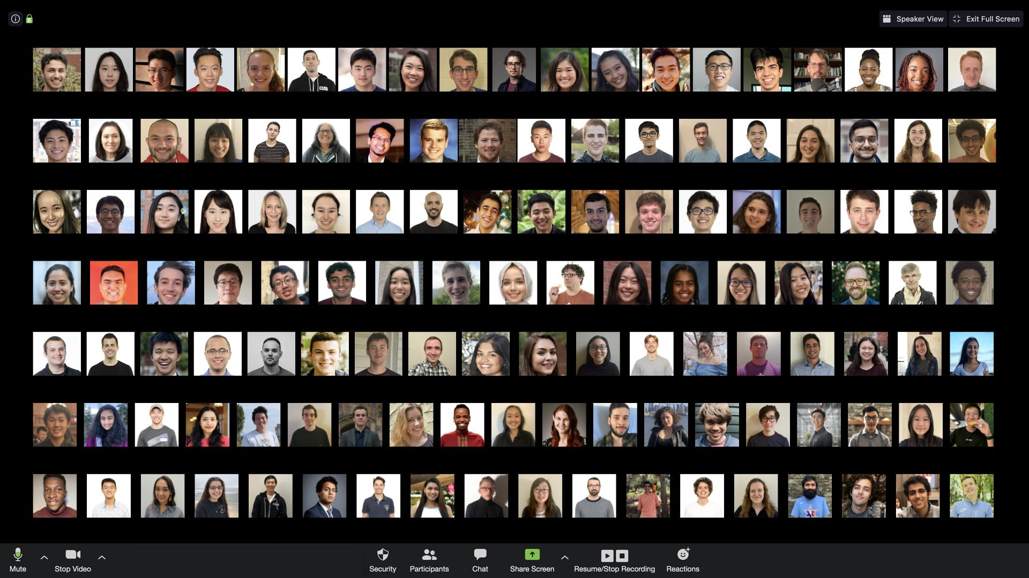

Slide 9

Notes:
https://www.fesliyanstudios.com/royalty-free-music/downloads-c/funny-music/21

Slide 10
what ultimately matters in this course is not so much where you end up relative to your classmates but where
you end up relative to yourself when you began

Slide 11


Slide 12
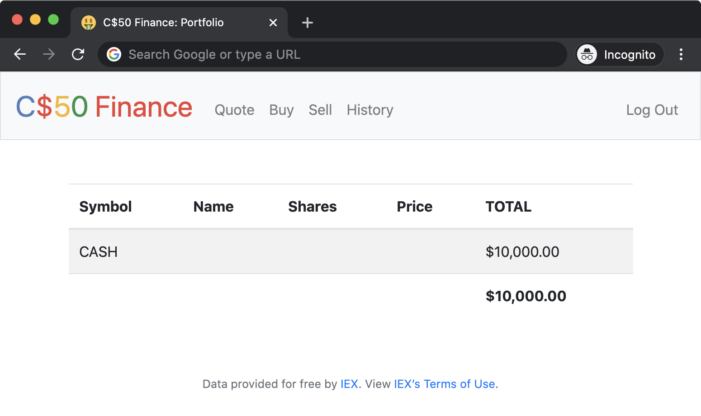

Slide 13
computational thinking

Slide 14
critical thinking

Slide 15
input →
→ output

Slide 16
correctness, design, style

Slide 17
abstraction

Slide 18
precision

Slide 20

Notes:
Inspired by https://classic.csunplugged.org/programming-languages/.

Slide 22

Notes:
https://www.pinclipart.com/pindetail/TbJixb_snowman-drawing-clipart/

Slide 24
This is CS50

Slide 25
ethics

Slide 26
This is CS50

Slide 27
programming

Slide 28
asking questions

Slide 29
finding answers

Slide 30
reading documentation

Slide 31
teaching yourself new languages

Slide 32
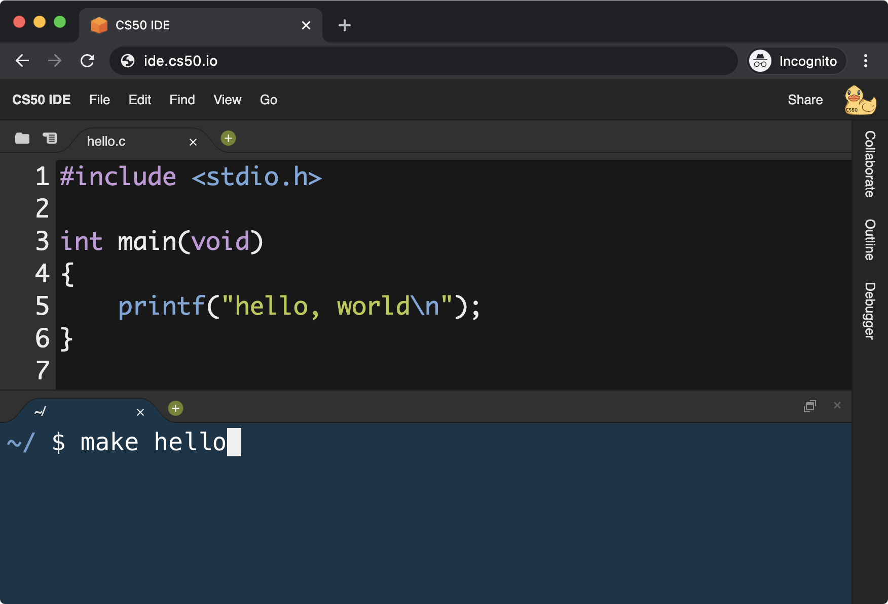

Slide 33
Install command-line tools
https://developer.apple.com/xcode/ https://docs.microsoft.com/en-us/windows/wsl/about ...

Slide 34
Learn Git
https://youtu.be/MJUJ4wbFm_A ...

Slide 35
Try VS Code
https://code.visualstudio.com/

Slide 36
Host a web site
https://pages.github.com/ https://www.netlify.com/ ...

Slide 37
Host a web app
https://www.heroku.com/platform ...

Slide 38
Host a web app
https://aws.amazon.com/education/awseducate/ https://azure.microsoft.com/en-us/free/students/ https://edu.google.com/programs/students/ ...

Slide 39
Keep reading
https://www.reddit.com/r/learnprogramming/ https://www.reddit.com/r/programming/ https://stackoverflow.com/ https://serverfault.com/ https://techcrunch.com/ https://news.ycombinator.com/ ...

Slide 40
Stay in touch
https://discord.gg/cs50 https://www.facebook.com/groups/cs50 https://www.facebook.com/cs50 https://gitter.im/cs50/x https://github.com/cs50 https://www.instagram.com/cs50/ https://www.linkedin.com/groups/7437240/ https://www.linkedin.com/school/CS50/ https://www.quora.com/topic/CS50 https://www.reddit.com/r/cs50 https://cs50x.slack.com/ https://www.snapchat.com/add/cs50 https://soundcloud.com/cs50 http://cs50.stackexchange.com/ https://twitter.com/cs50 http://www.youtube.com/cs50 ...

Slide 41


Slide 42
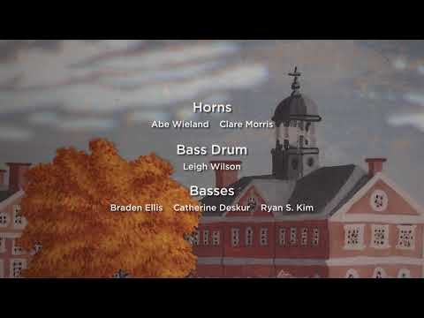

Slide 43
This was CS50

